Slide 1
The analytical story of changes in the unemployment rate
Jason Yang

Slide 2
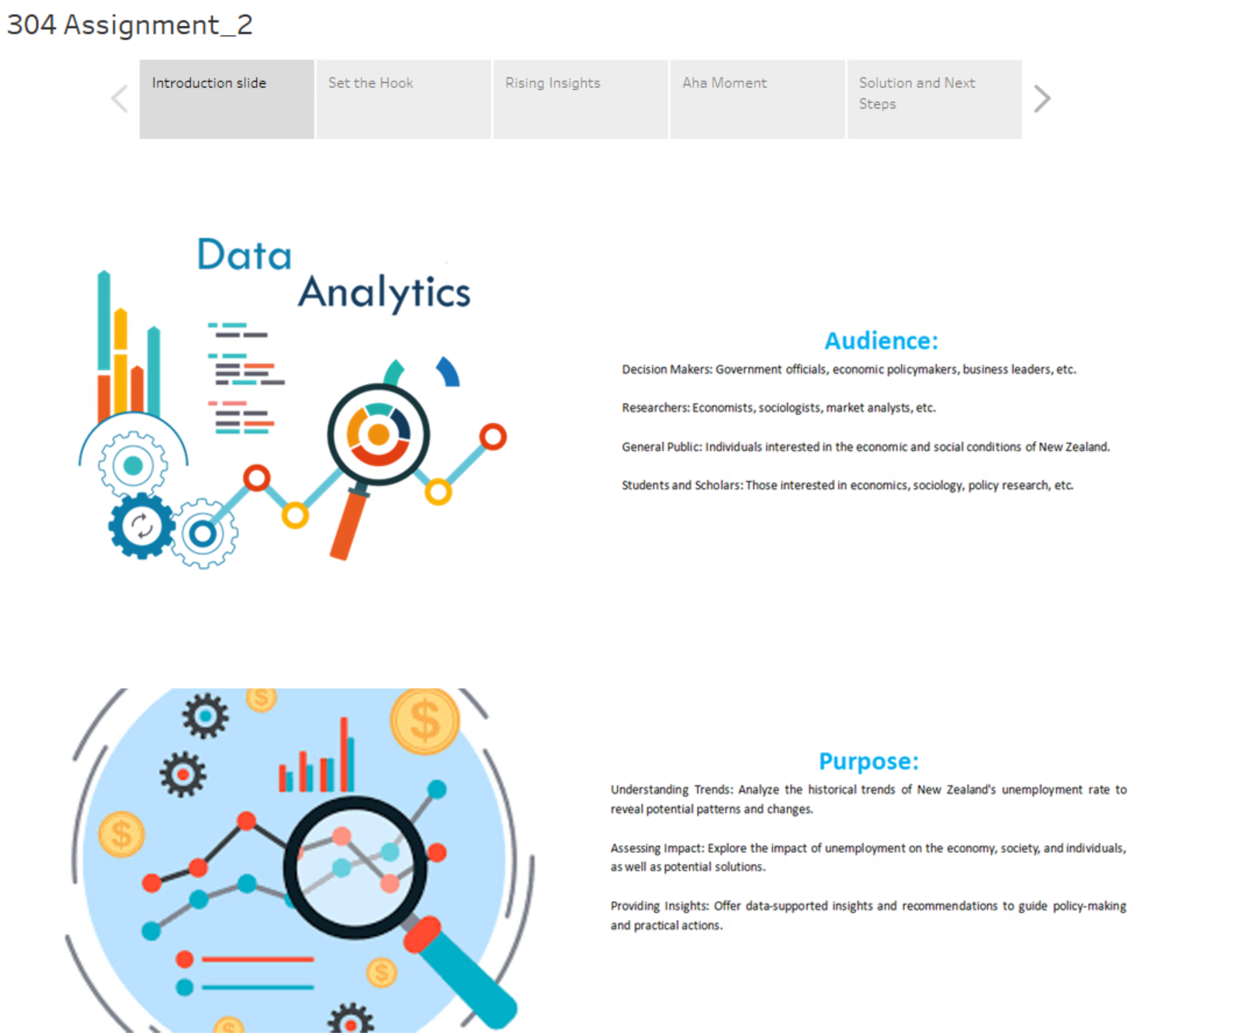

Slide 3
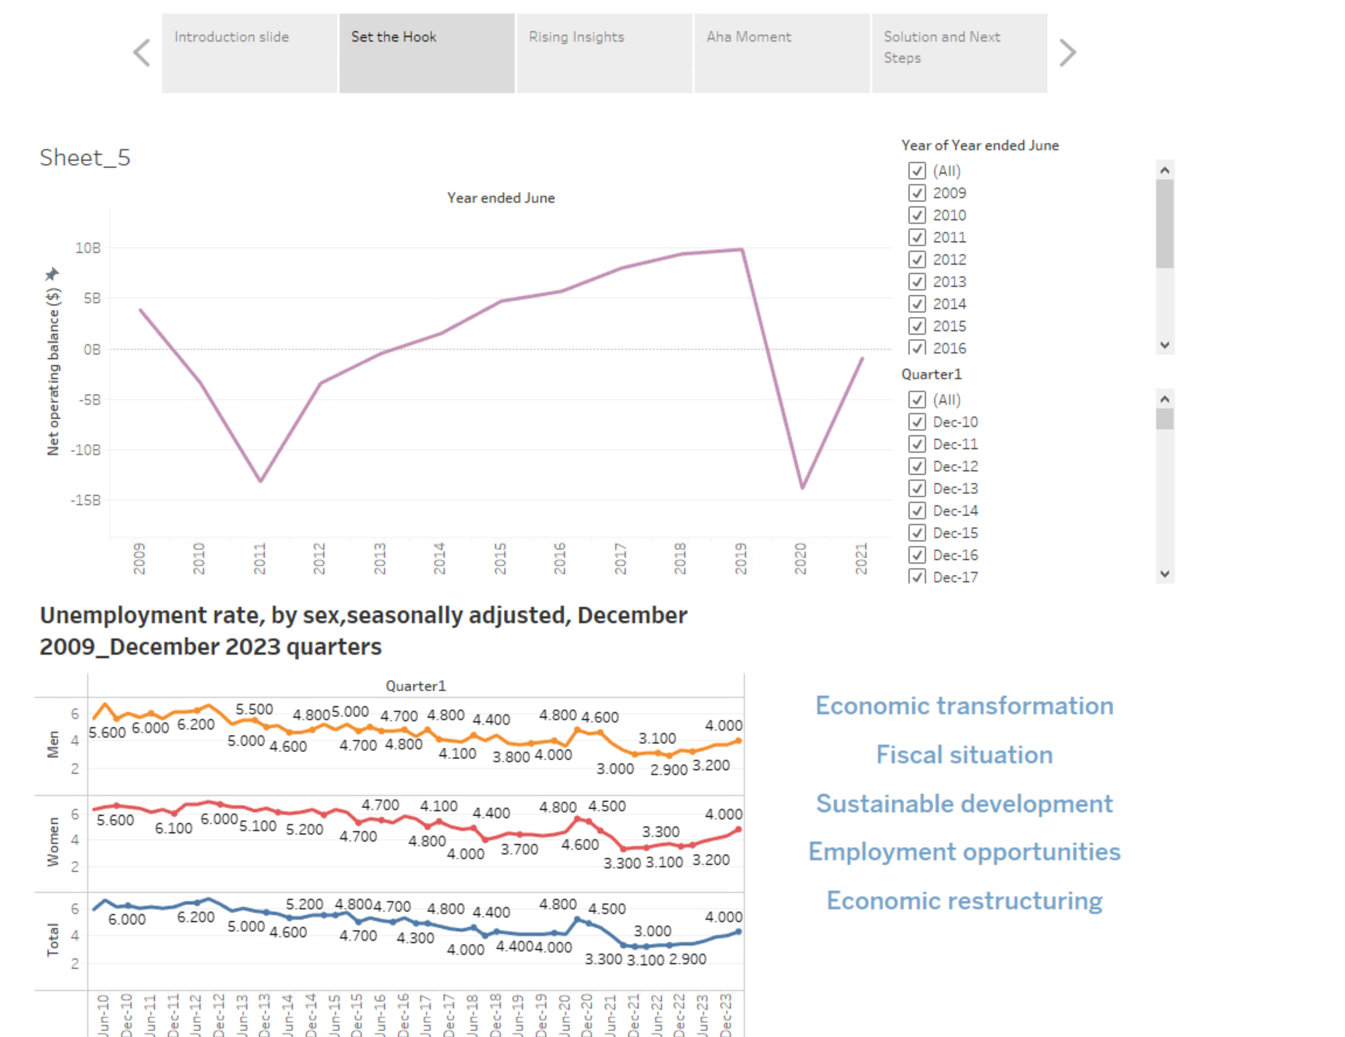

Slide 4
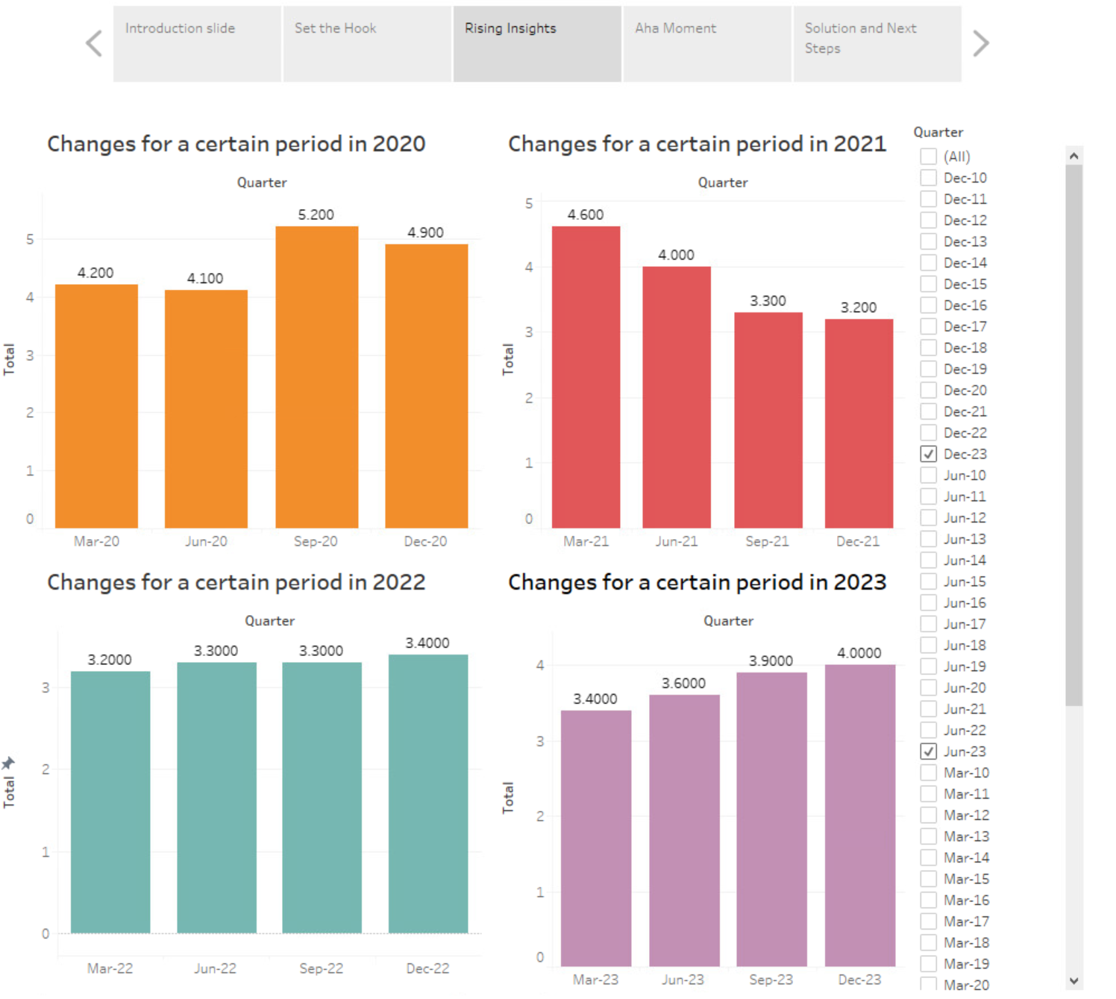
Stability of the New Zealand economy
Influencing factors
Social organizations

Slide 5
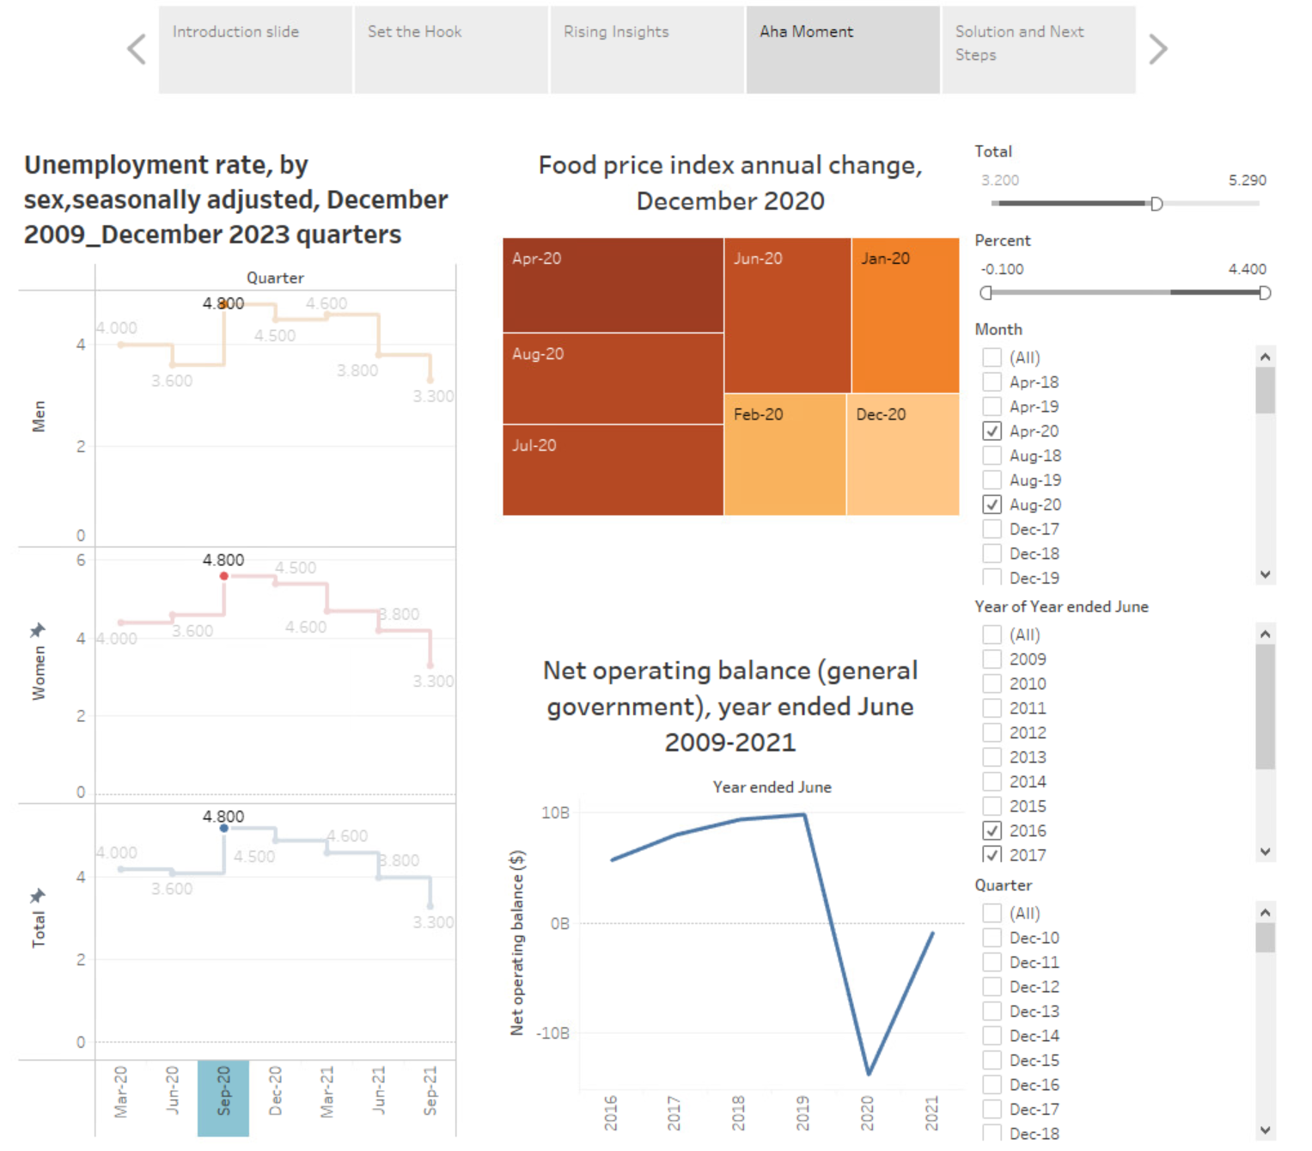
Economic recovery
Turning point
Cooperation

Slide 6
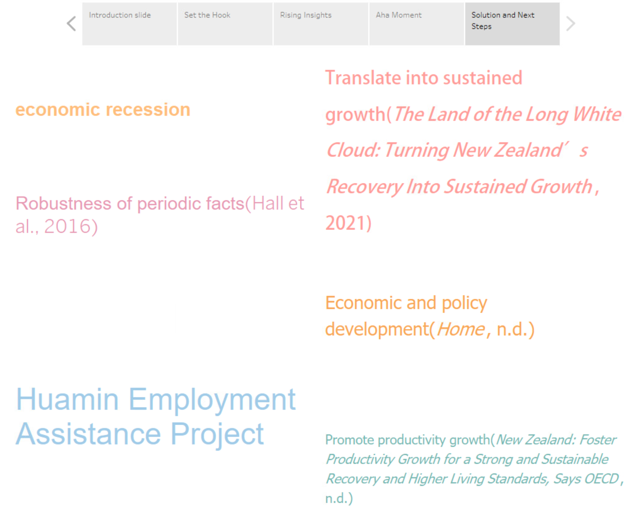

Slide 7
Reference：
1. New Zealand: Foster productivity growth for a strong and sustainable recovery and higher living standards, says OECD. (n.d.). https://www.oecd.org/newsroom/new-zealand-foster-productivity-growth-for-a-strong-and-sustainable-recovery-and-higher-living-standards.htm.
2. Home. (n.d.). https://www.oecd-ilibrary.org/sites/e1a5801d-en/index.html?itemId=/content/component/e1a5801d-en.
3. The Land of the Long White Cloud: Turning New Zealand’s Recovery into Sustained Growth. (2021, May 25). IMF. https://www.imf.org/en/News/Articles/2021/05/25/na052521-the-land-of-the-long-white-cloud-turning-new-zealands-recovery-into-sustained-growth.
4. Hall, V., Thomson, P., & McKelvie, S. J. (2016). On the robustness of stylised business cycle facts for contemporary New Zealand. New Zealand Economic Papers, 51(3), 193–216. https://doi.org/10.1080/00779954.2016.1189956.

Slide 8
Thanks for watching!
Jason Yang

